Slide 1
ARM Design Challenge 2017
Next-Generation-Automobile-Technologies
Team Members:
1. Niket Shah
2. Shreyash Palande
3. Ankesh Patil
4. Sameep Pote

Slide 2
Goal
Build an Autonomous vehicle based on the given TVS Automotive & ARM Cortex M4 platforms
The several advantages of an autonomous vehicle includes reduction in traffic, accidents, increased fuel efficiency as well as reduction in the air pollution caused due to standard engine powered vehicles.

Slide 3
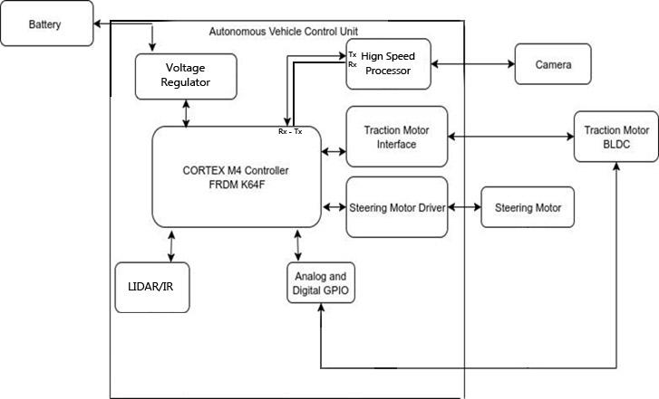
Functional Block Diagram

Slide 4
Schedule of the Work:
Month | Task
December | Interfacing traction motor driver,Stepper motor(for steering) with FRDM master and Camera with laptop
January | Implementing various image processing algorithms on laptop and tasks on FRDM board
February | Establish communication between master and slave and generate various control signals depending upon the data
March | Integrating all the modules and testing the system for various conditions

Slide 5
Design and Engineering Details

Slide 6
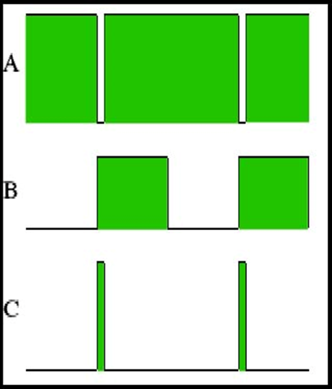
Traction Motor Interface
The speed of the traction motor is controlled via Pulse width modulation (PWM)
Changing the ON time and OFF
Time of the pulse the averaged DC
Voltage is varied

Slide 7
Pictures of the Waveform :
•The motor is on for most of the time and only off a short while, so the speed is near maximum
•The switch is on 50% and off 50%.
•The motor will only rotate slowly.

Slide 8
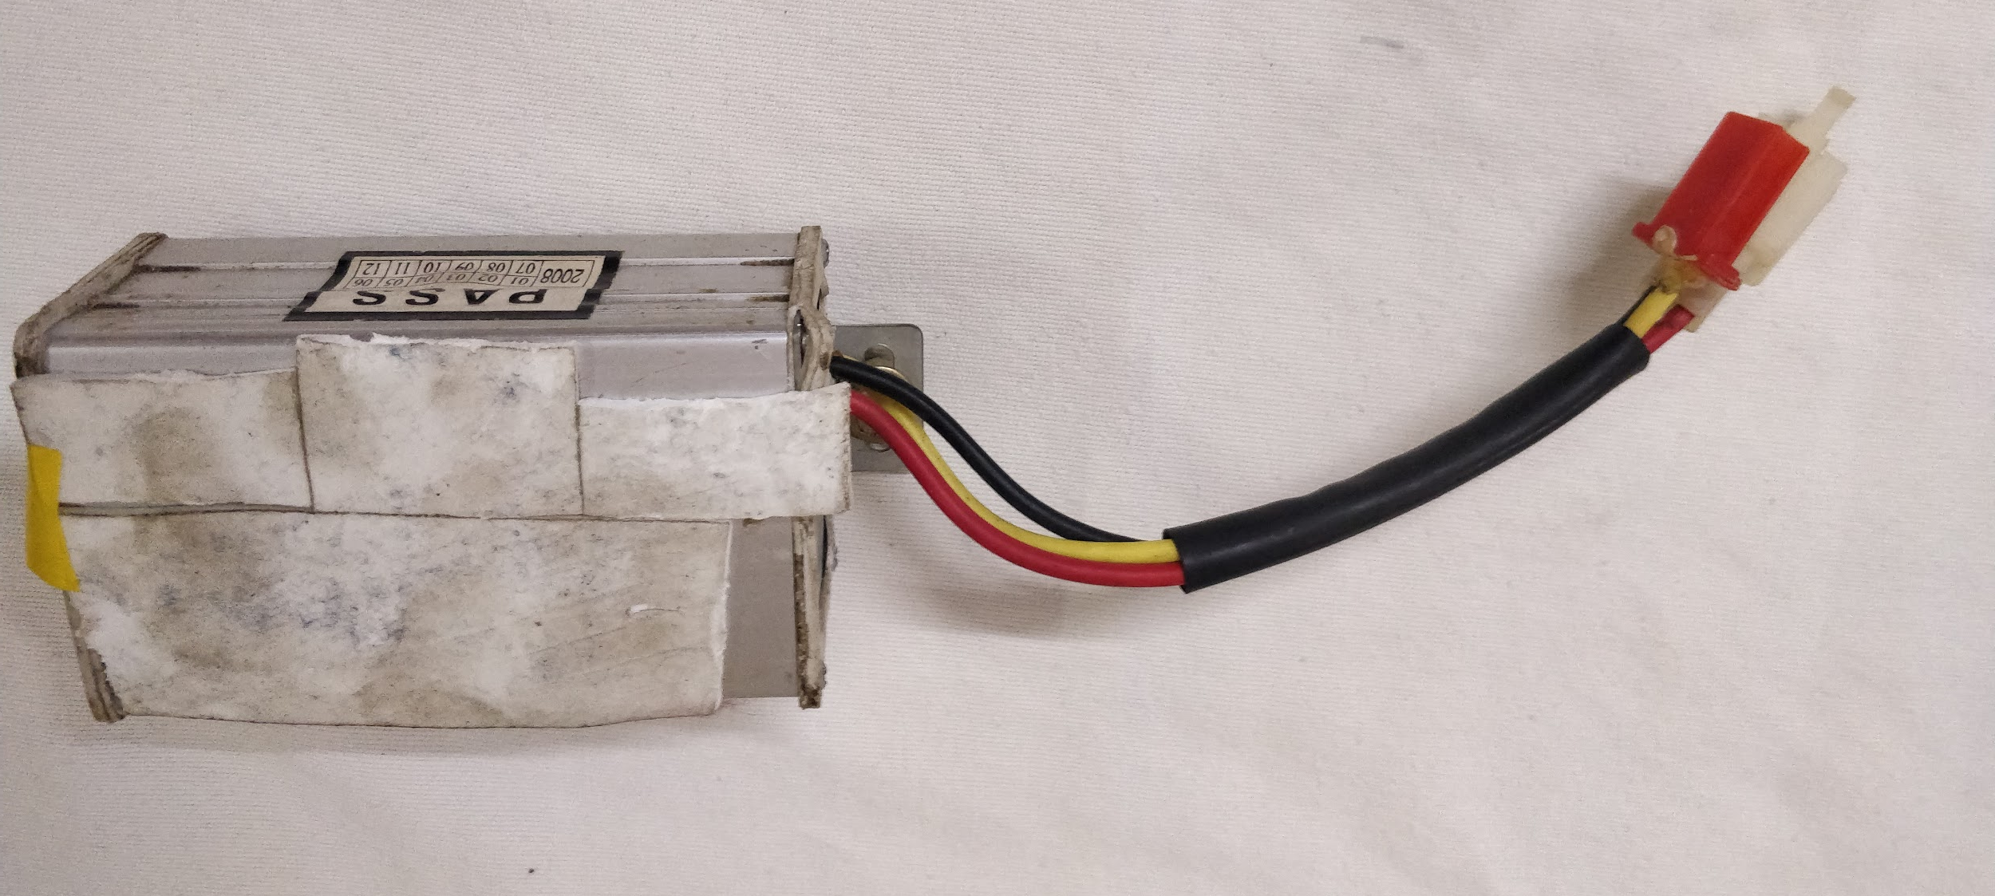
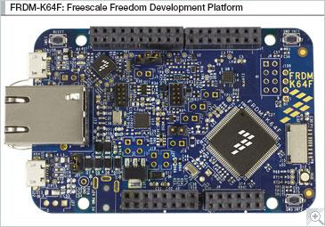
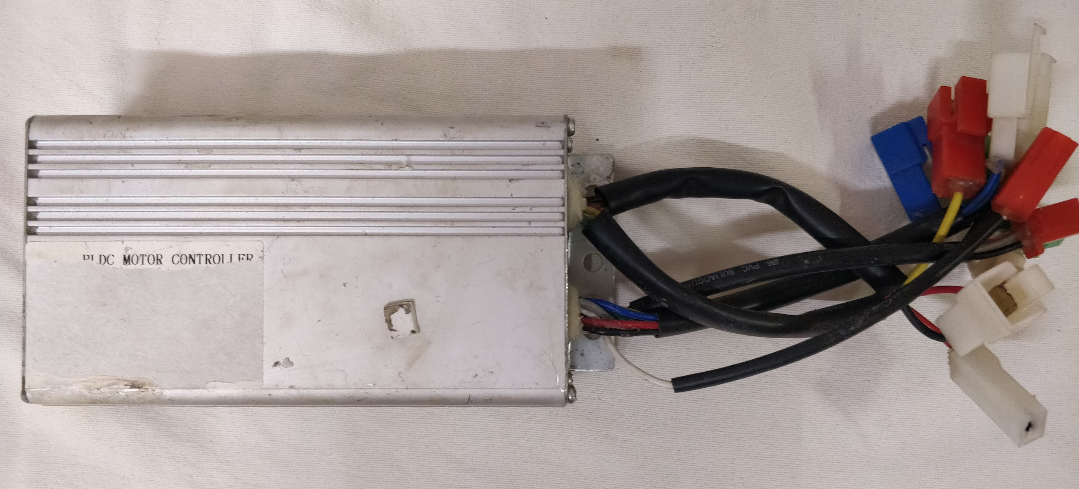
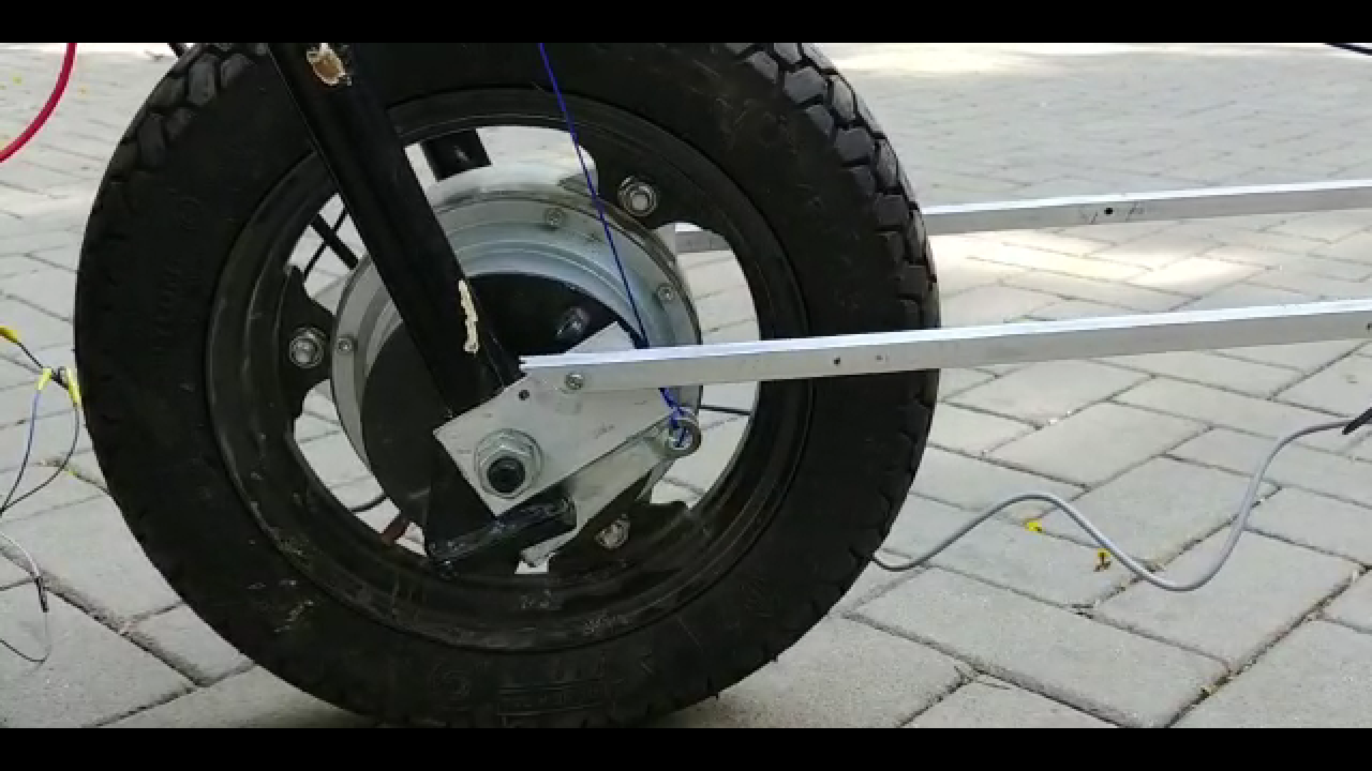
Traction Motor Interface
Supply battery
Variable DC voltage
PWM out
DC-DC Converter
FRDM K64F
48V BLDC Motor Controller
3 phase BLDC motor

Slide 9
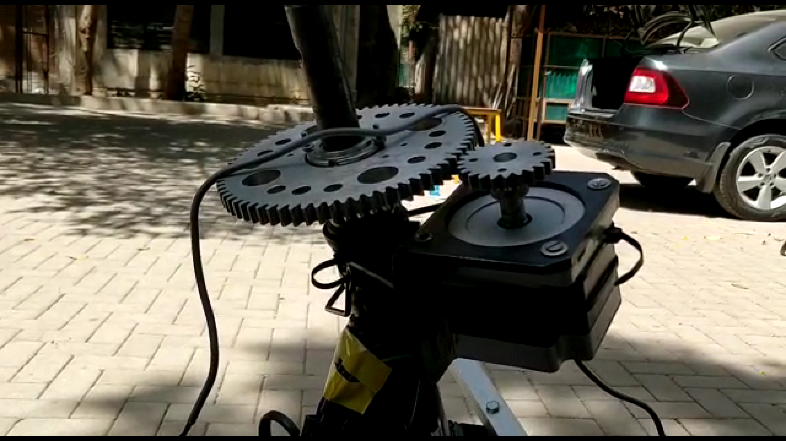
Design and Engineering Details
4.2: Steering Control Verification
Stepper motor for steering control
Motor with small gear and
Steering shaft with large
gear.

Slide 10
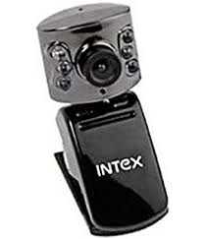

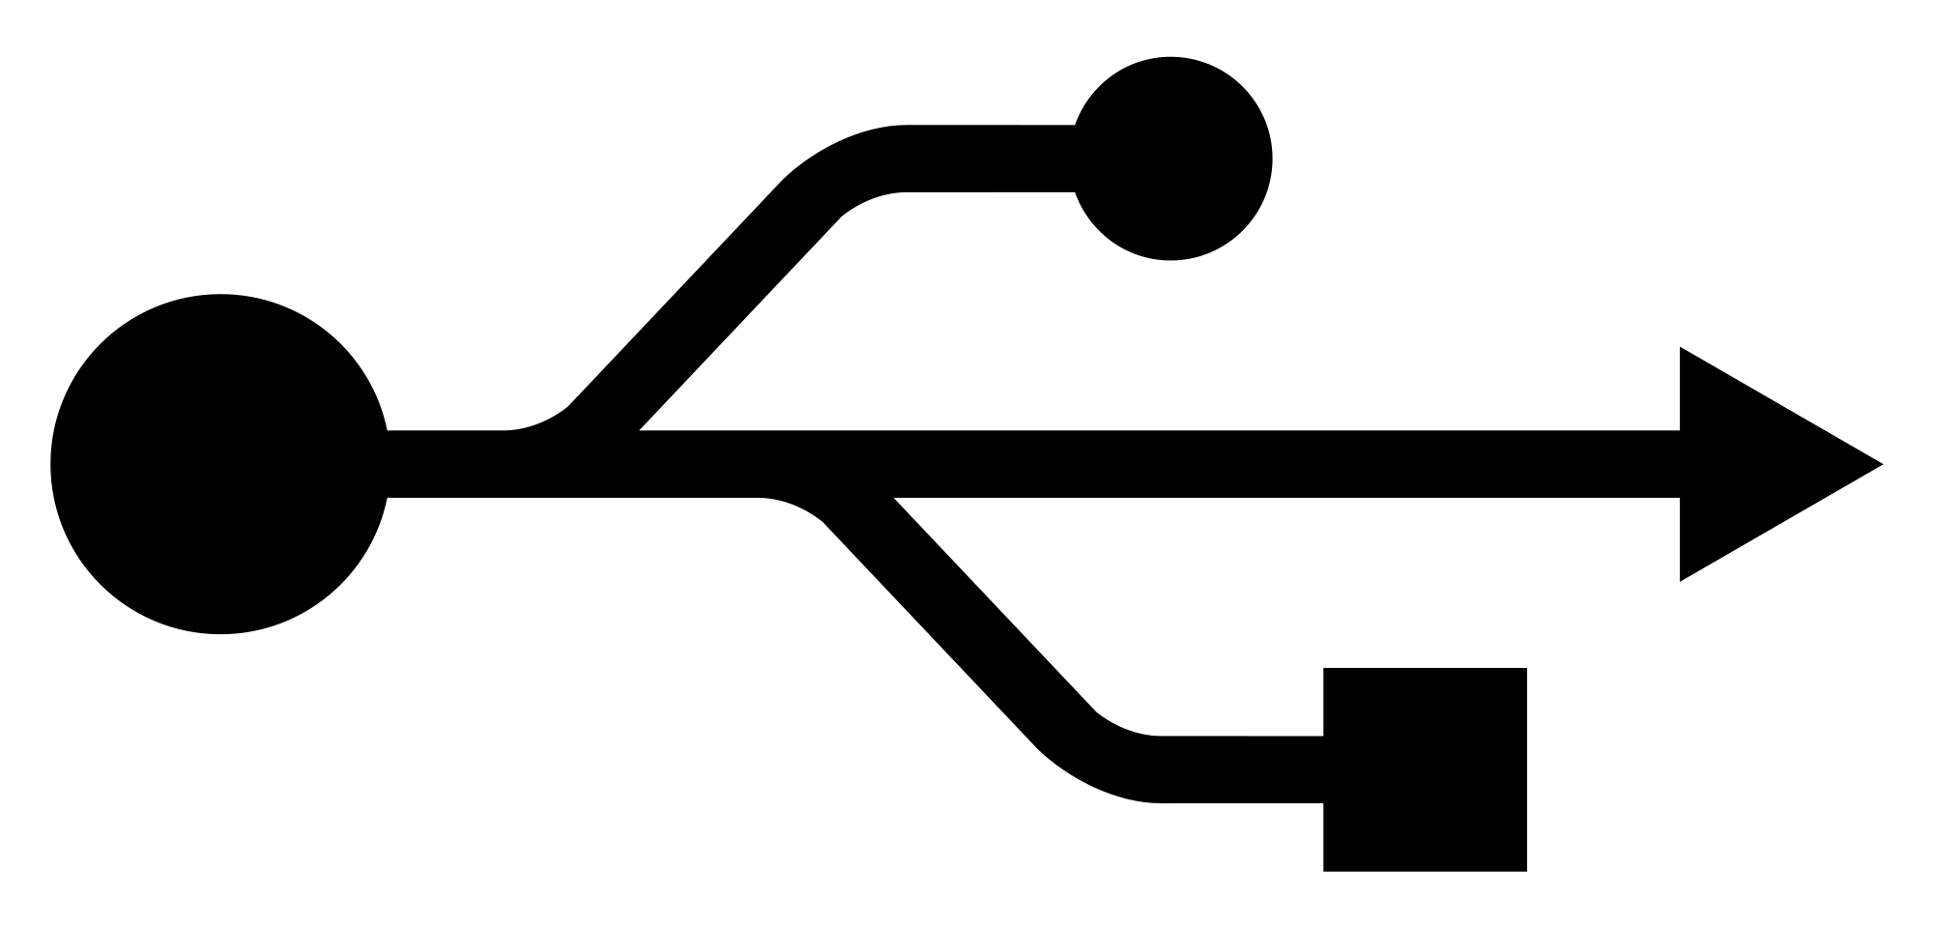
Design and Engineering Details
Line Graph Detection Interface
OpenCV in Python is used for Image Processing

Slide 11
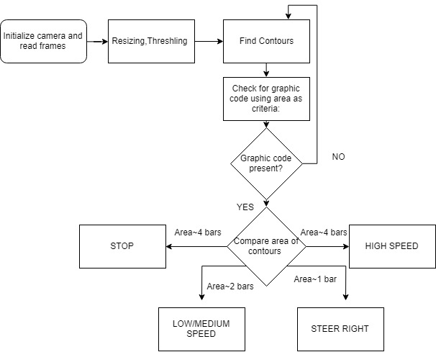
Design and Engineering Details
Line Graph Verification of all codes:

Slide 12
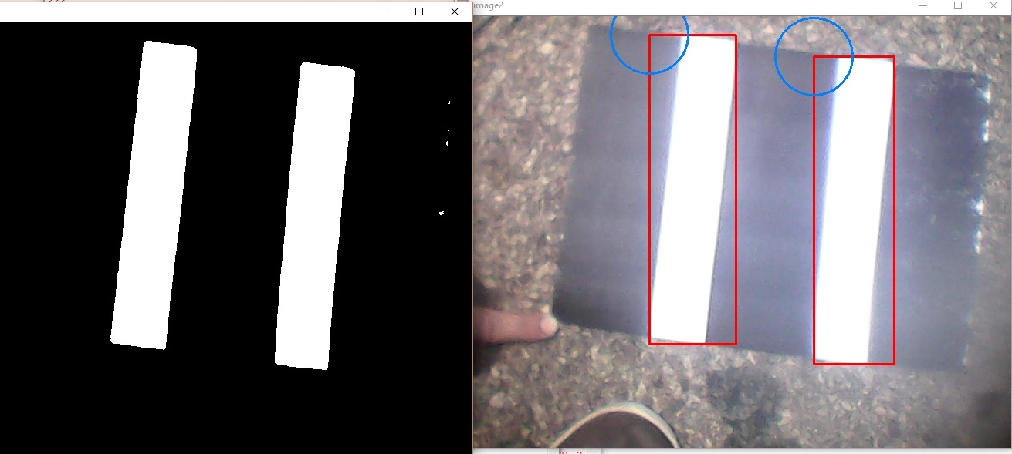
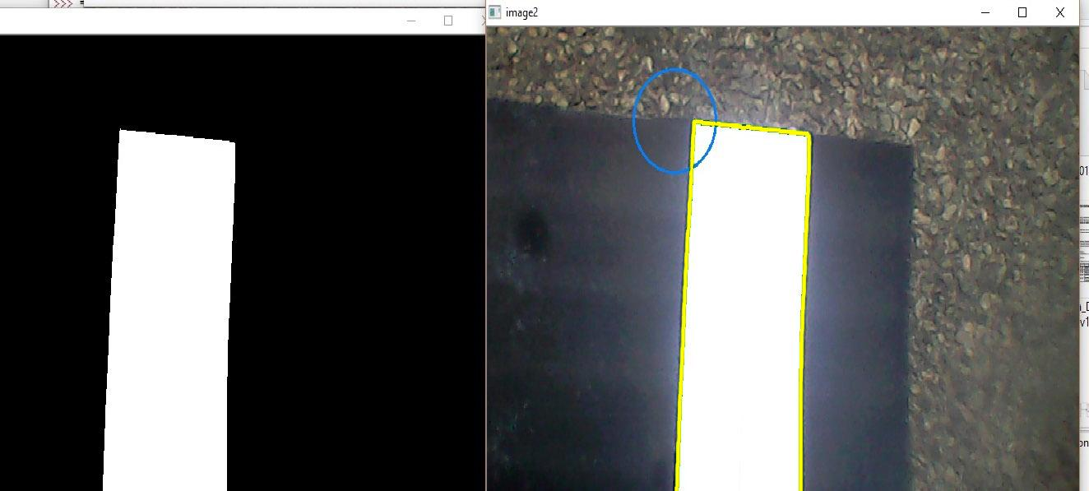
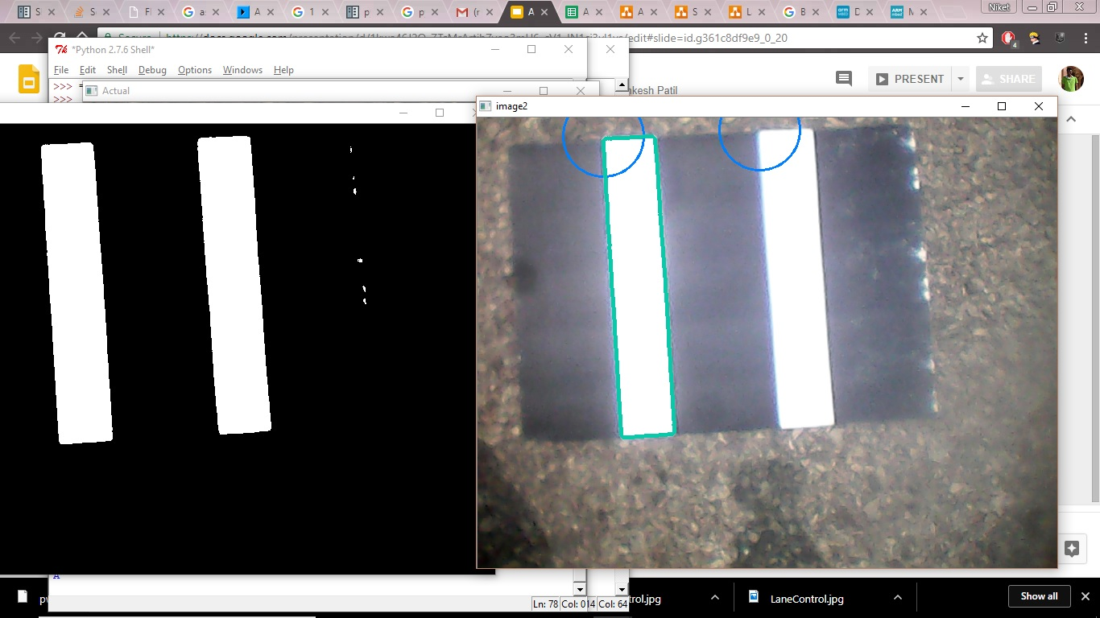
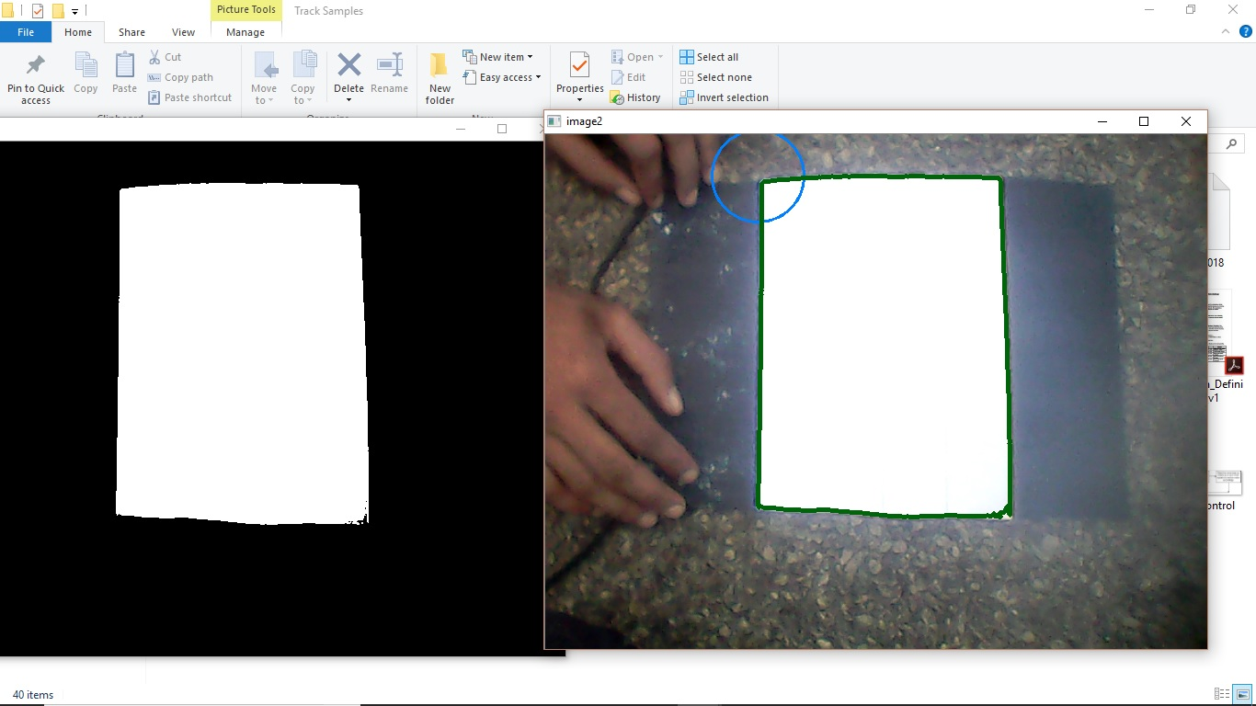
Line Graph Verification of all codes:

Slide 13
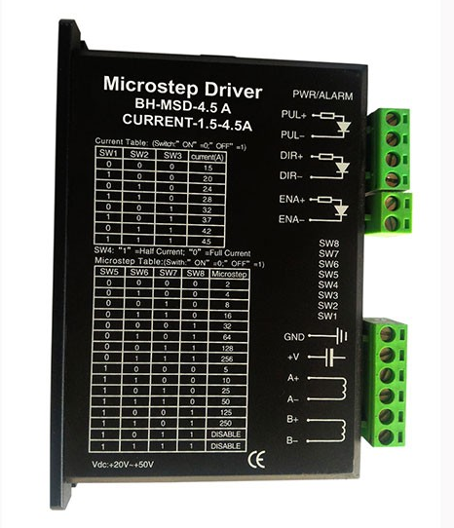
Design and Engineering Details
Steering Motor Interface Verification
Using Gyroscope connected on the steering, we can get the
exact rotation of the front wheel
Get the error from the desired value and correct it using PID algorithm
Direction
Pulse
Supply
Stepper Coil wires
Stepper Motor Driver

Slide 14
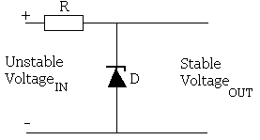
Design and Engineering Details
Speed Limit Setting
Zener diode is connected parallel to the supply to regulate the voltage so the speed doesn’t go above a threshold.

Slide 15
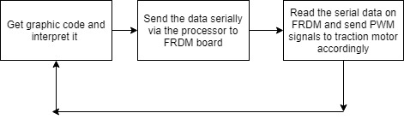
Design and Engineering Details
Speed Control Algorithm:
Zener diode is connected parallel to the supply to regulate the voltage so the speed doesn’t go above a threshold.

Slide 16
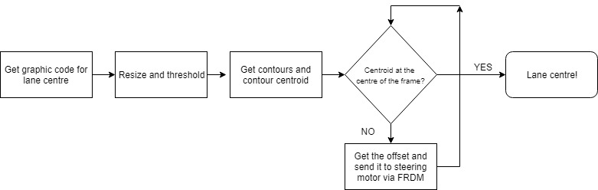
Design and Engineering Details
Lane Control Algorithm:

Slide 17
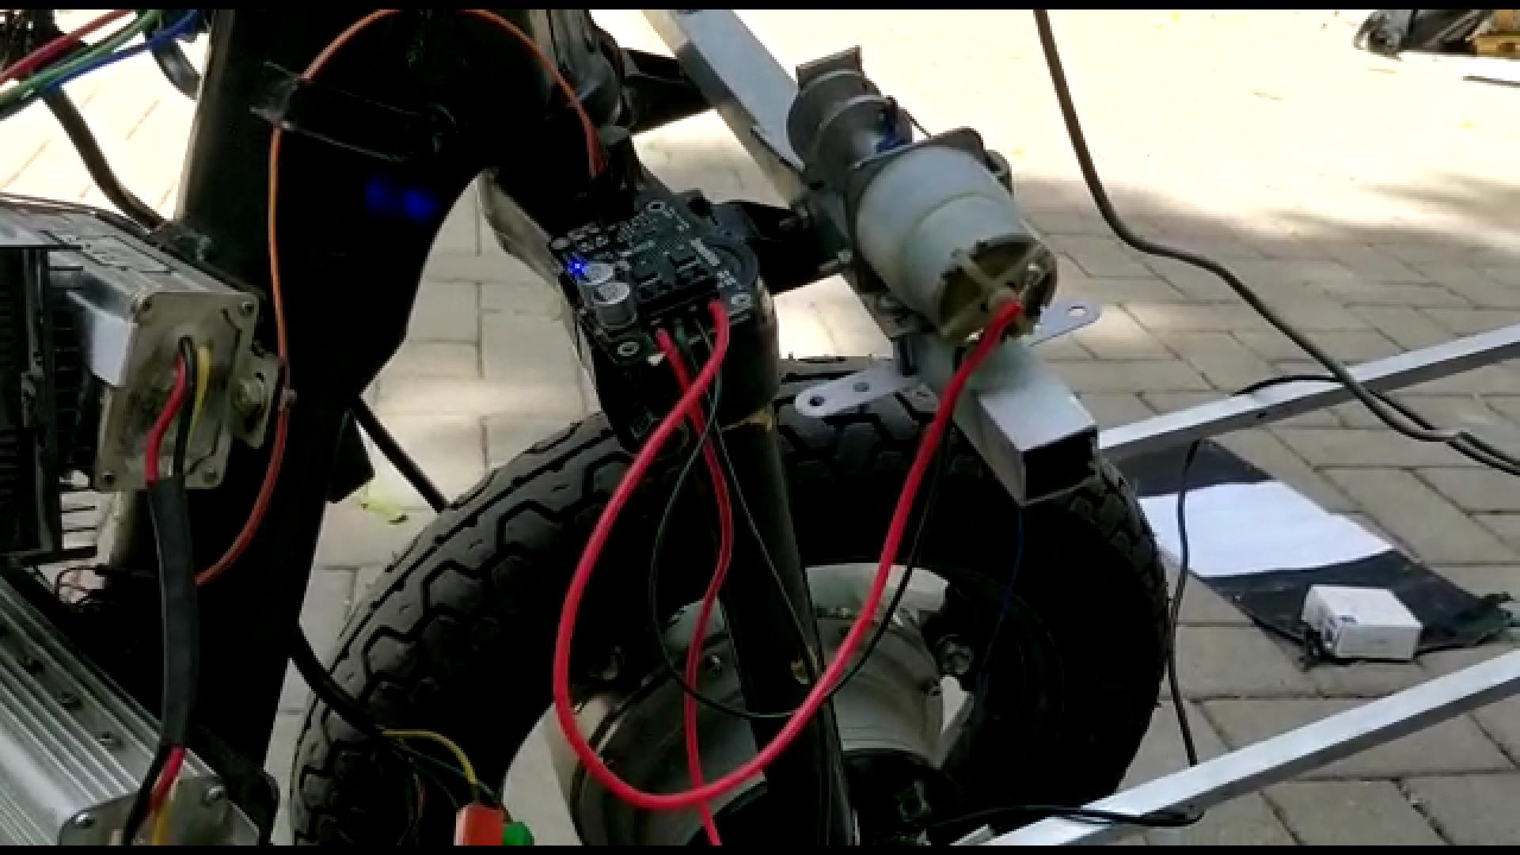
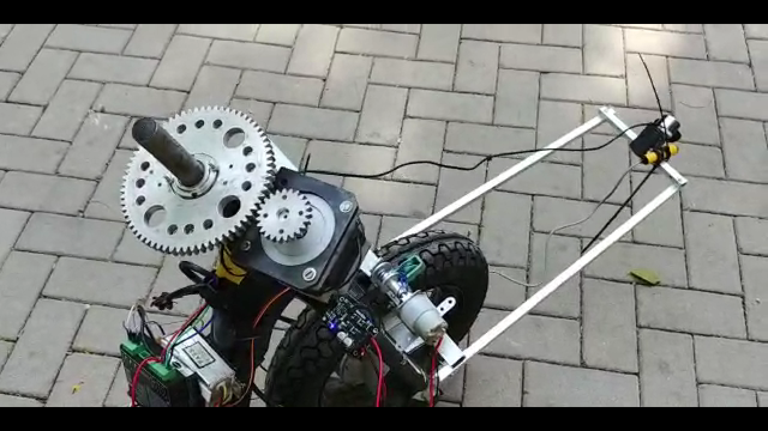
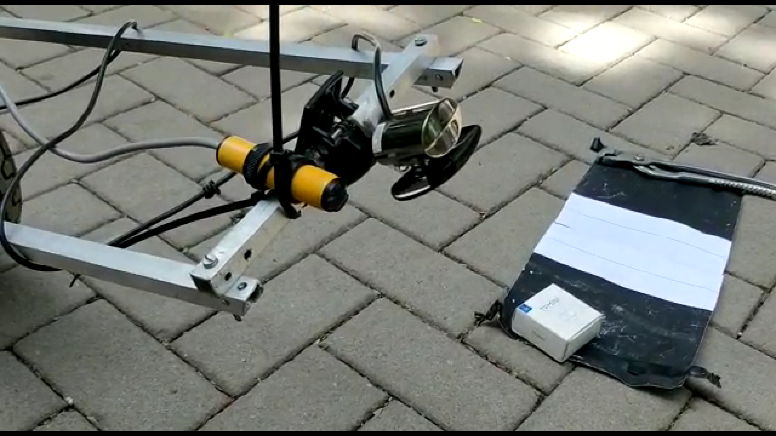
Hardware Design

Slide 18
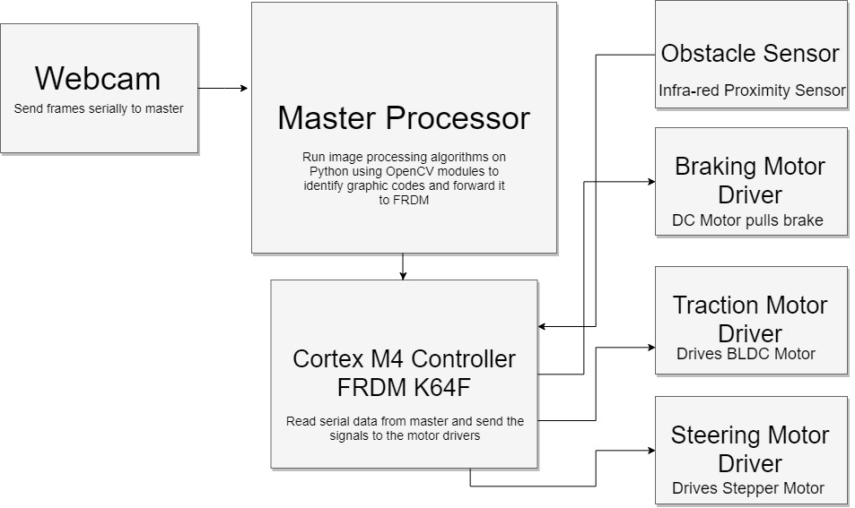
Software Design

Slide 19
Learnings from the participation in challenge
Image Processing algorithms
Interfacing of several devices on FRDM board
Communication between two devices
Building different mechanisms for an autonomous vehicle
Considering parameters for making a vehicle autonomous

Slide 20


Slide 22
THANK YOU!!

